Slide 1
1, log uniform [1e-6, 75]
2, log uniform [1e-6, 75]
3, log uniform [1e-6, 75]

Slide 2
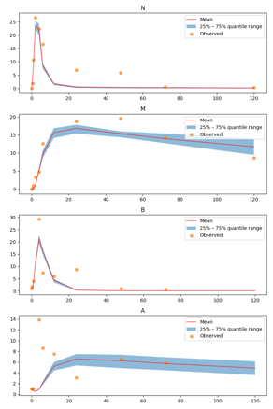
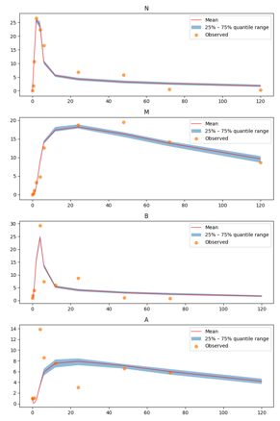
1, log uniform [1e-6, 25]
2, log uniform [1e-6, 25]
3, log uniform [1e-6, 25]

